Slide 1


Crystal's Journey to Sustainability
Kenneth Lo
Chairman of Crystal Group
19th October, 2011

Slide 2
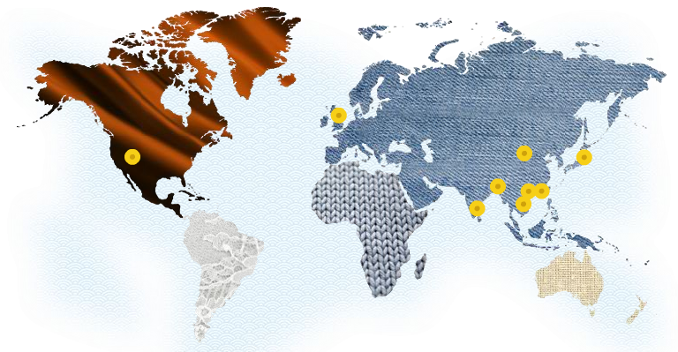
Year of Establishment: 1970
Employee: 35,000
Production base: PRC, Vietnam, Bangladesh, Sri Lanka
Market base: US, EU, Japan
Annual production: 200M pieces

Slide 3

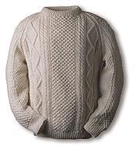
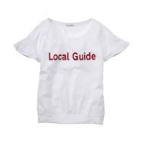
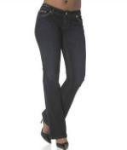


About Crystal
Crystal Martin UK (2005)
Elegance Industrial Co. Ltd. (1974)
Crystal Apparel Co. Ltd. (1982)
Crystal Martin FE (2005)
Crystal Sweater Ltd. (1982)

Slide 4














Global Customer Base

Slide 5
Start from oneself and go beyond……
It all started from one film……
“An Inconvenient Truth - Al Gore”
More “ passionate ” about the commitment we need to make
Be sustainable
  BEYOND simple regulatory compliance
Start from Top-down,
all people agree & support!
  Passion

Slide 6
Our Environmental Objectives
Sustainable solutions in operations
  Environmental Efficiency
  Contribute to triple bottom line
  Save Costs
Drive environmental awareness
Crystal
Customers
Government
Suppliers
Employee & Families
Community

Slide 7




Eco Approach

Slide 8




5-Year Environmental Targets
Save up 20% of energy cost
Reduce material wastage by 30%
Plant 1,000,000 trees
Reduce carbon footprint per garment 8%

Slide 9
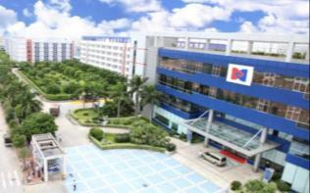
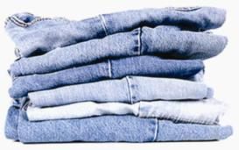
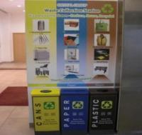
For a Sustainable Business
Sustainable
product
Green factories
ZERO landfill

Slide 10

Our Focuses
Energy Saving
Water Conservation
Waste Elimination
More than 100 activities… IN FACTORY

Slide 11
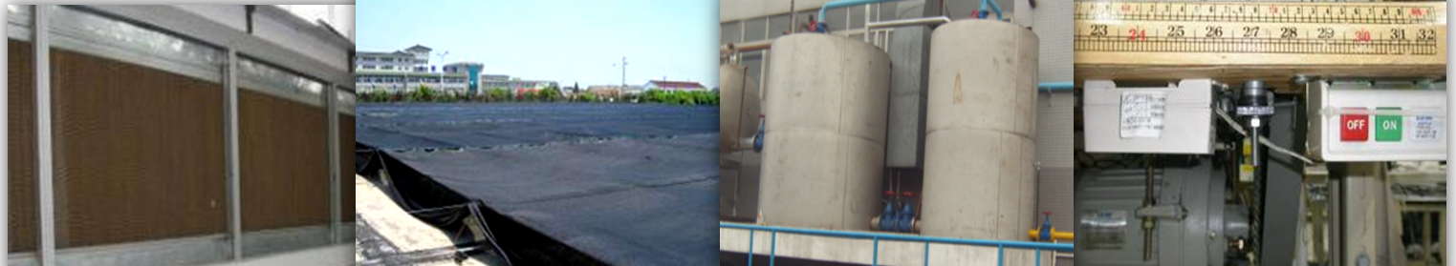
Energy Saving
Areas | Improvements made | Payback
Lighting System | T5, LED & energy saving lamps | 7 months
HVAC | Water Curtain | 14 months
Energy Recovery | Steam condensation | 6 months
Production Equipment | Variable Frequency Devices (VFD) | 10 months
HVAC: Heating, Ventilation and Air Conditioning

Slide 12
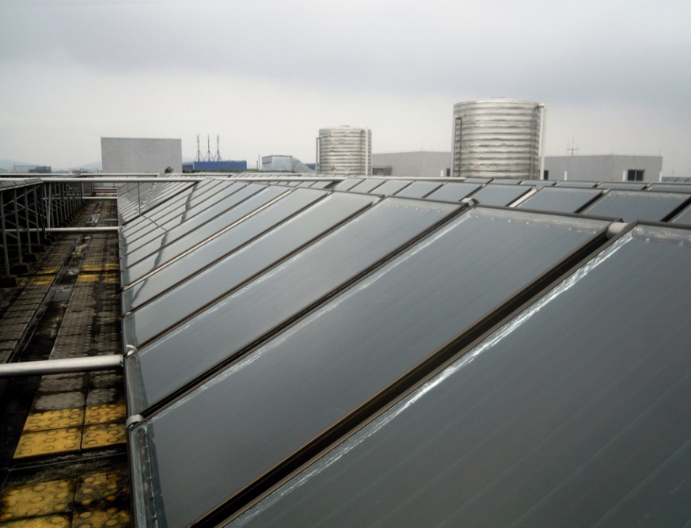
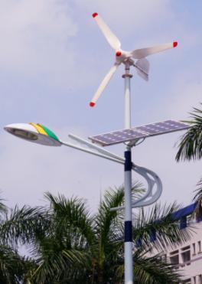
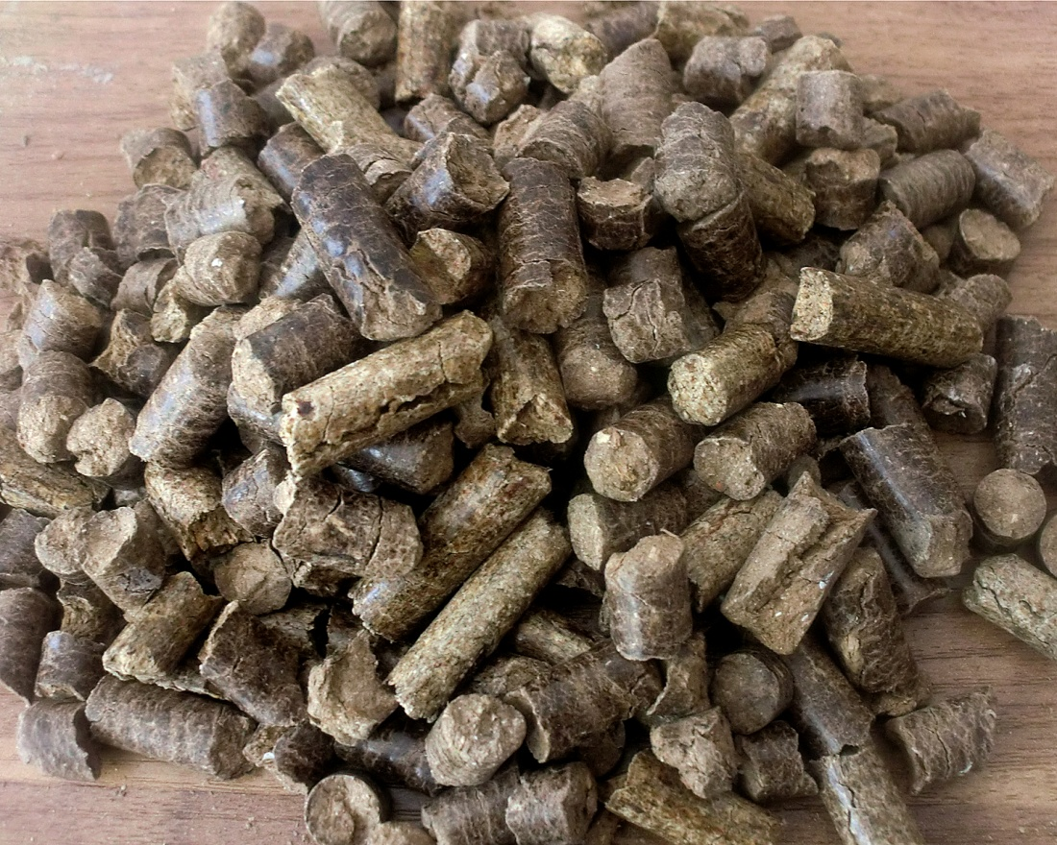
Renewable Energy
Type | Application
Solar Energy | Hot water supply for production & dormitory
Solar Energy | Road lamp
Wind Power | Road lamp
Biomass Fuel | Boiler

Slide 13
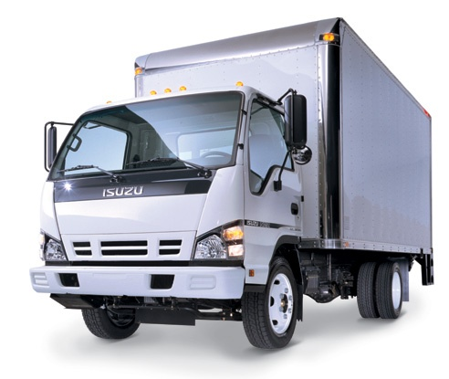
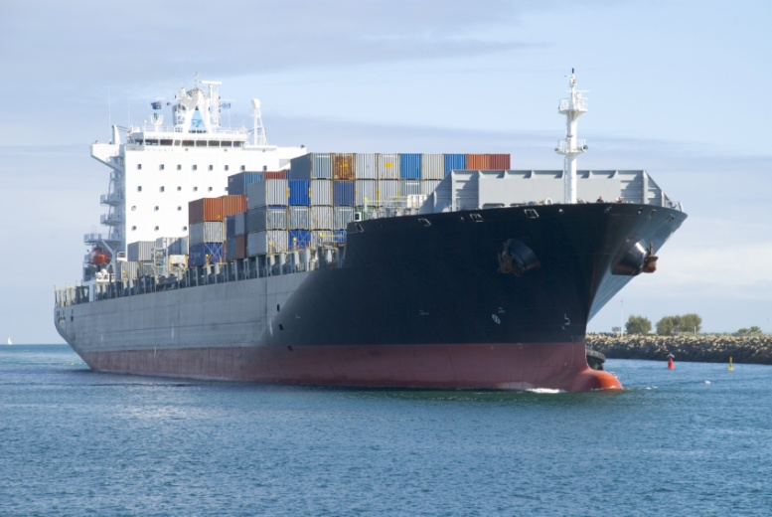
Green Logistics
  Cost Saving
    HK$ 4 million in 1 year
  Quicker response
  67% CO₂ saved

Slide 14

Water Conservation
Target
Zero discharge
  Less fresh water use

Slide 15
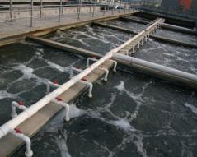
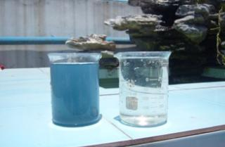
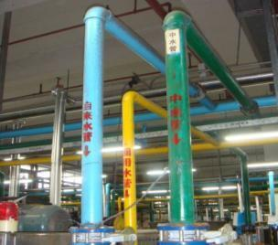
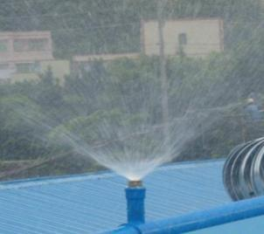
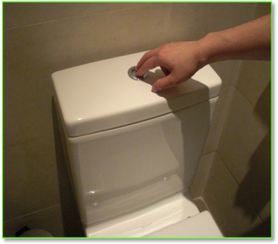
Water Recycling
＞80% Reuse

Slide 16
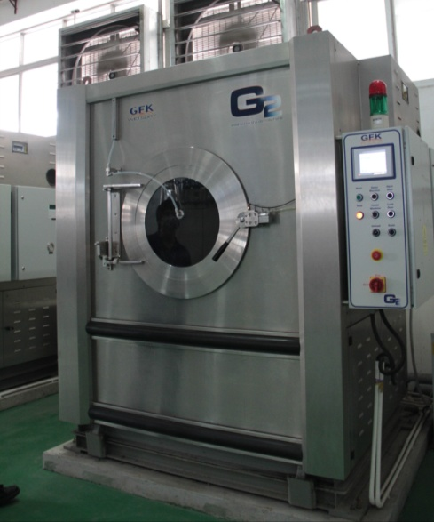
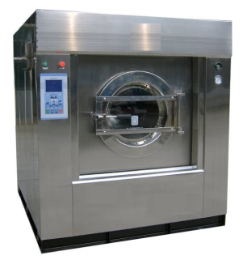
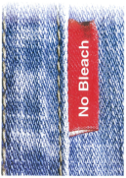
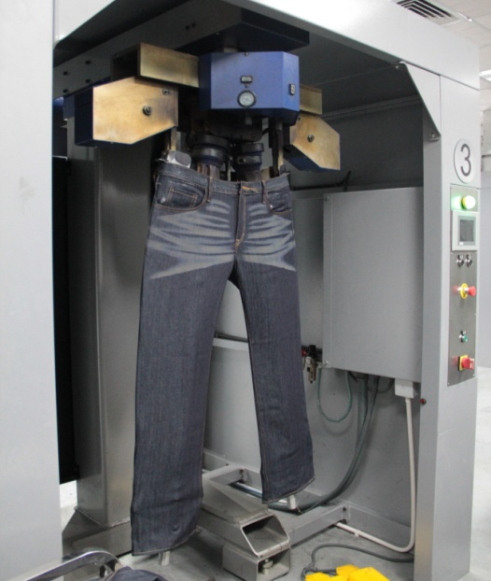
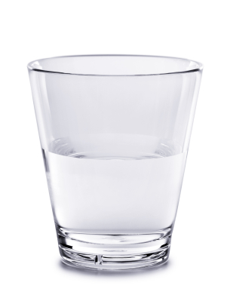
Innovative Technologies
G2 Technology
Front Loading
↓ Water
↓ Manpower
↓ Chemical
Eco-softener
Laser
Notes:
Ecosoftener 換相

Slide 17


Waste Elimination
Target:
ZERO Landfill
零堆填

Slide 18
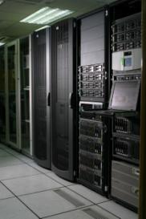
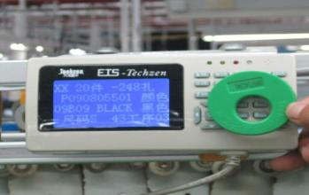
Paper-less
  Production e-Ticket: ETS
  ERP System
  Electronic Documentation Management
  e-Form
  e-Banking
Saved 90% paper

Slide 19
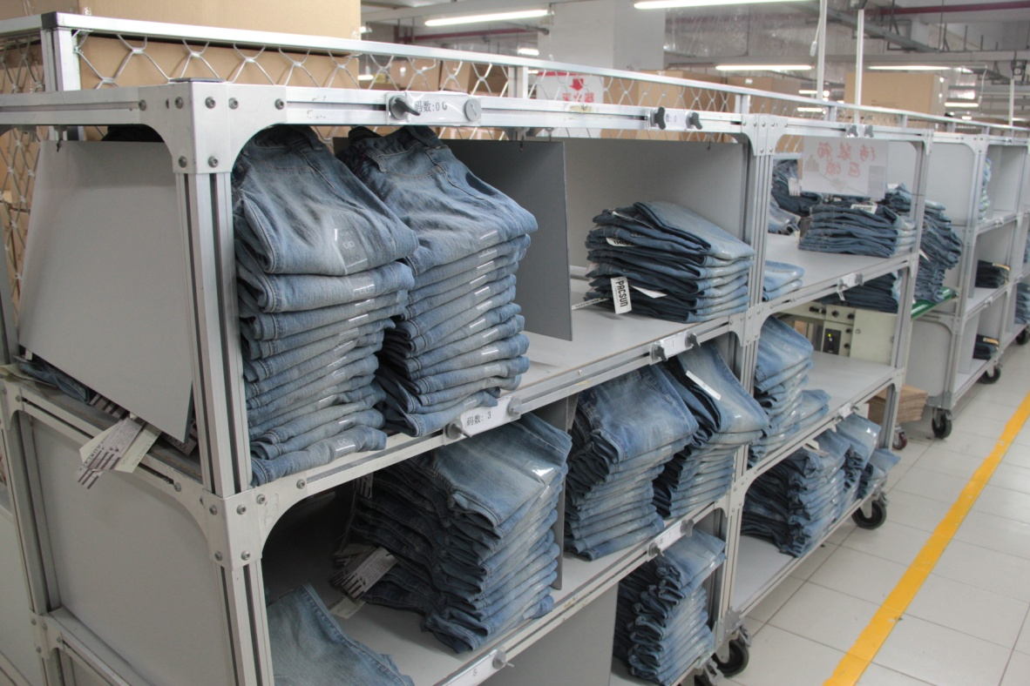
Making the Best Use
  Lego-like structures, ease for re-design
    can be used over and over
Notes:
Add Patent

Slide 20
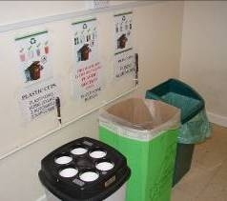
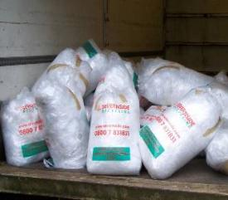
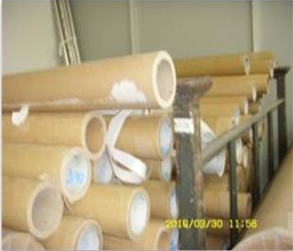
Waste Recycling
  Ease & encourage recycling:
    Proper segregation
    Collection
    Education

Slide 21
Turn Food Waste into Treasure
Handling Food Waste
Fertilizing Organic Garden
Composting to Organic Fertilizer

Slide 22
Progress
Save up 20% of energy cost
Reduce material wastage by 30%
Plant 1,000,000 trees
Reduce carbon footprint per garment 8%
8%
25%
940,578
(Up to Jul 2011)
Achieved
Notes:
International Award

Slide 23



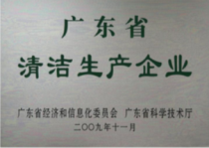
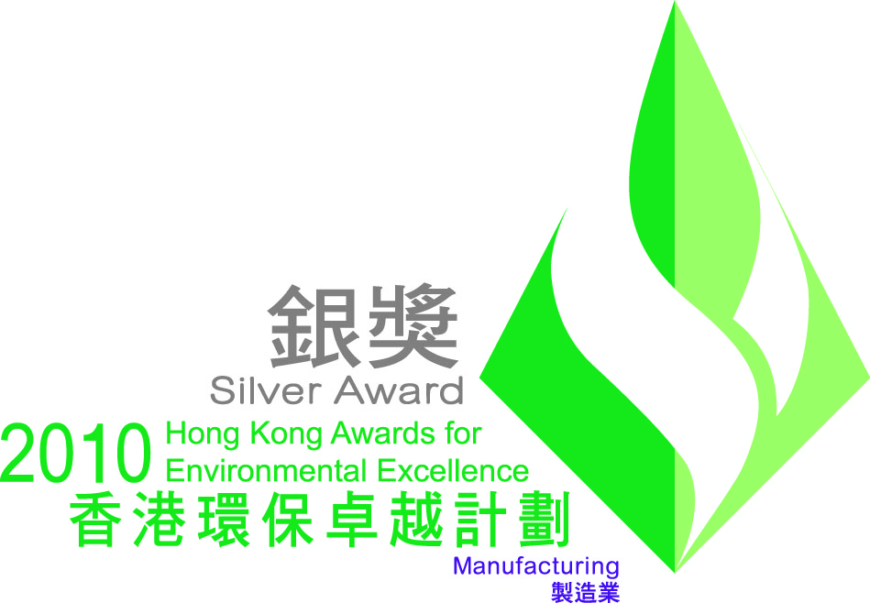

Eco Achievement
  Low Carbon Manufacturing Programme
  Hang Seng – Pearl River Delta Environmental Award
Totally 27
Eco-Awards
  Cleaner Production Award
  HKAEE –
  Silver Award (Manufacturing)
  ISO 14001 Certification

Slide 24
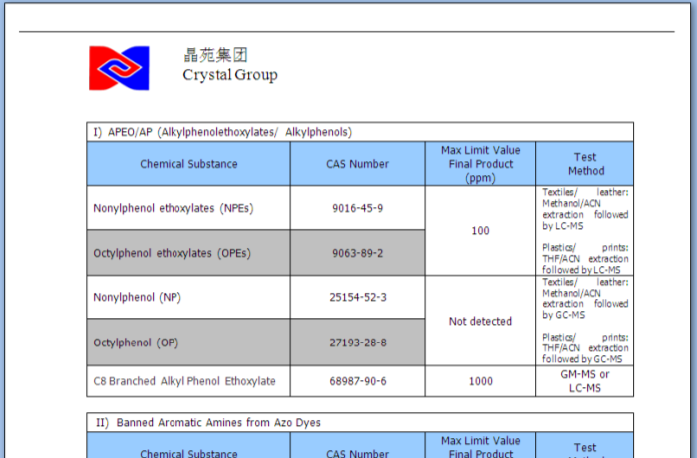
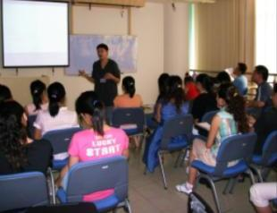
Culture Building
Crystal Product Safety Requirement
Environmental & Chemical Safety Seminars
(Employees, factories & suppliers)

Slide 25
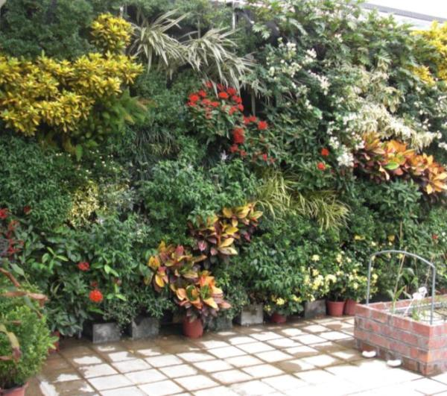
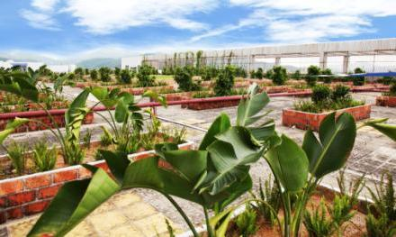
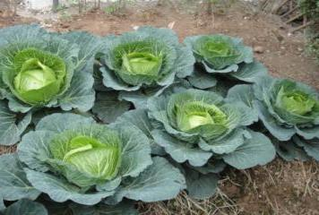
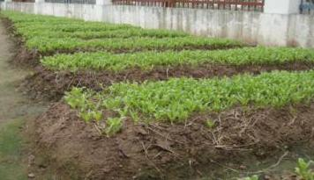
Green Culture

Slide 26
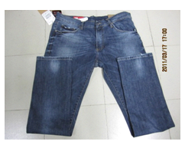
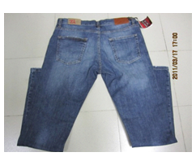
Eco–Jeans Project with Marks & Spencer
The Plan A attributes:
  Recycled cotton
  Less carbon emission
  Less water
  New design of sustainable packaging
  Green logistics
+ Sweater Factory in Sri Lanka
→ Plan A Eco Attribute Factory

Slide 27
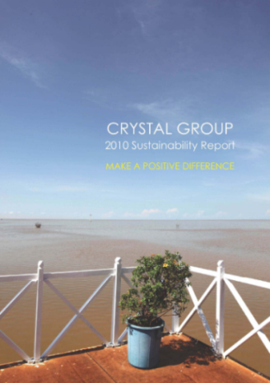
Our journey goes on……
For sustainable development:
  The Environment
  Community Engagement
  Employee Care
  Product Integrity
  Innovation
“Being Responsible – A perfect business sense”

Slide 28

Low Carbon Manufacturing
    ISO 50001
Next 5-Year target
    Water
    Zero Landfill
Chemical Management
Supplier Collaboration
  More sustainable practices

